Slide 1
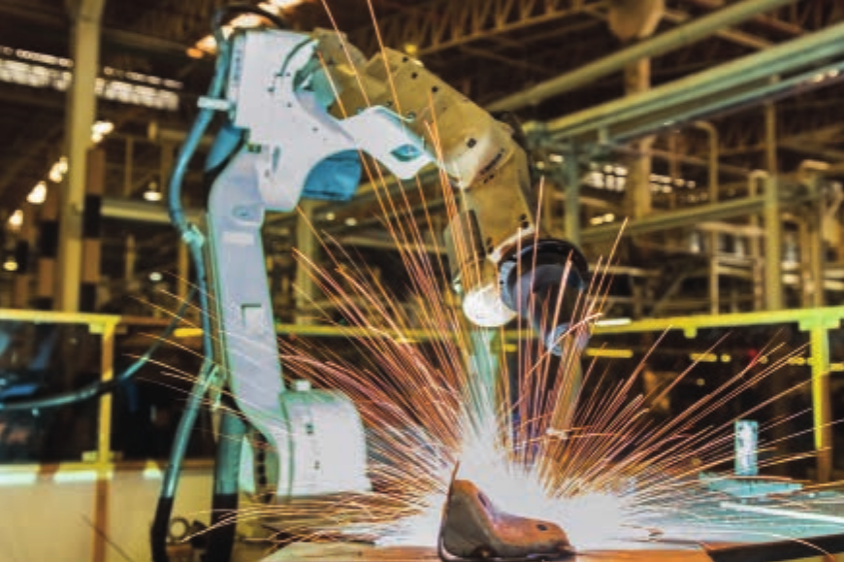
Robotics
IGCSE Computer Science 0478 | 6.2
1
Notes:
Covers 0478 syllabus 6.2: what robotics is, the characteristics of a robot, and the roles, advantages and disadvantages of robots in industry, transport, agriculture, medicine, domestic use and entertainment. Content follows the Hodder Cambridge IGCSE Computer Science textbook, section 6.2. Exam questions in the booklet are real 0478 Paper 1 questions (2023-2025) with official marking points in these notes.

Slide 2
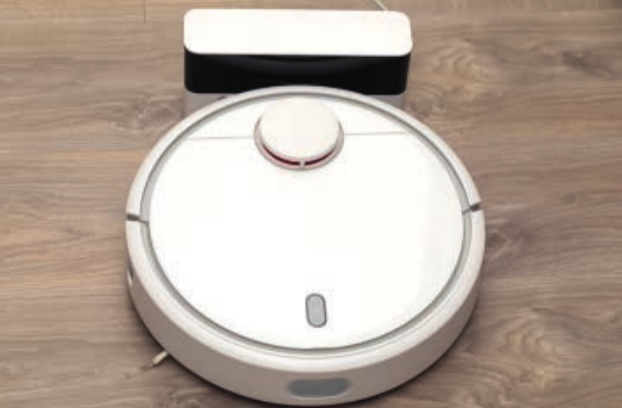
Recall test: automated systems (6.1)
Starter activity
Booklet Task 1 covers... | Marks
Match six sensors to a suitable use | 6
State what is meant by an automated system (Oct/Nov 2024) | 1
Describe the role of the microprocessor (Oct/Nov 2024) | 3
Give two benefits of sensors in an automated system (May/June 2024) | 2
1
Closed book
No notes or slides. 8 minutes, then swap and mark with your teacher.
2
Notes:
Booklet Task 1, closed book, 8 minutes, then swap and mark. Robotics questions always assume students can explain the sensor - microprocessor - actuator loop from 6.1.
ANSWERS
Q1 (6): acoustic = water dripping from a leak / glass breaking; humidity = moisture in a greenhouse; infra-red = person approaching automatic doors / motion; magnetic field = counting cars in a car park; level = refilling a water bowl or tank; proximity = robot vacuum avoiding furniture.
Q2 (1) 0478/13 Oct/Nov 2024 Q5(a): a system that can perform actions without human intervention.
Q3 (3) 0478/13 Oct/Nov 2024 Q5(b): receives data from the sensor; analyses it / checks whether it is within or outside a range; sends signals to trigger actions (actuators) based on the data.
Q4 (2) 0478/13 May/June 2024 Q6(b), any two: data collected without human intervention; faster than a human; accurate readings; continuous 24/7; can work in dangerous environments.
Re-teach threshold: fewer than 2/3 on Q3 -> recap the 6.1 control loop before slide 16.

Slide 3
In this lesson, you will
Objectives
Explain what is meant by robotics, and tell a physical robot apart from a software "bot"
Describe the characteristics of a robot in the words examiners credit
Classify robots as independent or dependent, and explain what an end-effector does
Describe how a robot uses sensors, a microprocessor and actuators to carry out a task
Give advantages and disadvantages of robots in industry, transport, agriculture, medicine, the home and entertainment
3

Slide 4
What is robotics?
Activity 1
Robotics is a branch of computer science that brings together the design, construction and operation of robots.
1
Design
Physical robot? | Robot?
Robot welder in a car factory | Yes
Robot vacuum cleaner | Yes
Search engine web crawler ("bot") | No: software only
Website chatbot | No: software only
Planning what the robot must do and how it will be built.
2
Construction
Building the mechanical and electrical parts.
Physical robot: a robot welder
3
Operation
Think-pair-share: why is a web crawler called a "bot" if it is not a robot?
Programming and running it to carry out tasks.
Images: Hodder Cambridge IGCSE Computer Science, Chapter 6.2.
4
Notes:
Mark scheme (0478 Feb/March 2023 Q6(b), 2 marks): the design / the construction / the operation of robots (to perform tasks). Students need two of the three words. "Robot" comes from the Czech "robota" (forced labour), first used in the 1920 play R.U.R. Asimov's three laws are interesting context but are not examined.
Think-pair-share: is a search engine web crawler a robot? No: it is software only. The syllabus treats robots as physical machines.

Slide 5
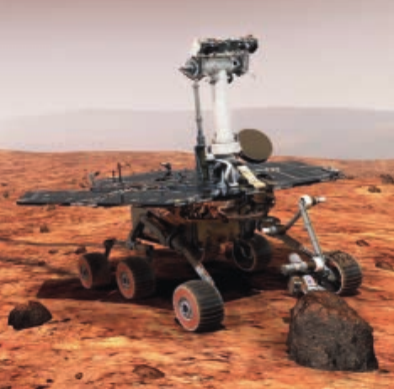
Characteristics of a robot
Activity 1
1
Mechanical structure
2
Electrical components
3
Programmable
A physical framework that moves, grips or lifts: arms, joints, wheels, gears, pistons, end-effectors.
Sensors to sense the surroundings, a microprocessor to process the data, actuators and motors to move.
A controller (the "brain") follows stored instructions to decide what to do, often using sensor data.
Exam wording to use | Avoid writing
"It has a mechanical structure / framework" | "It is made of metal"
"It has electrical components, such as sensors, a microprocessor and actuators" | "It has electricity"
"It is programmable" | "It is intelligent"
"It can move" (also credited) | "It looks like a human"
A Mars rover has all three
Images: Hodder Cambridge IGCSE Computer Science, Chapter 6.2.
5
Notes:
Use the MARK SCHEME wording. 0478 May/June 2024 Q8(b), any three: mechanical structure/framework; electrical components; programmable; can move. 0478 May/June 2023 Q9(a) and the 2023 specimen Q6(a) give "mechanical structure" and ask for the other two: electrical components and programmable.
The textbook (6.2.2) words the list as: sense surroundings, movement, programmable (and its older activities say "perceived intelligence"). Students should write the mark scheme words. Sensing is credited as an example of electrical components.

Slide 6
Robot or not?
Activity 1
For each device, decide whether it is a robot. Justify your answer using the three characteristics.
Device | Mechanical structure? | Electrical components? | Programmable? | Robot?
Electric desk fan
Robot lawn mower
Autopilot software
Prosthetic hand with sensors
A device that moves is not automatically a robot, and a program that acts by itself is not a robot unless it has a physical body.
6
Notes:
Answers: electric fan - not a robot (it moves, but it is not programmable and has no sensors to decide what to do). Robot lawn mower - robot (frame and wheels, sensors and microprocessor, programmable). Autopilot software - not a robot on its own (software only), although the aircraft it flies is a robotic system. Prosthetic hand with sensors - robot (the textbook says modern prosthetic limbs meet all three characteristics). Students should justify each answer with the three characteristics, not with "it looks like a robot".

Slide 7
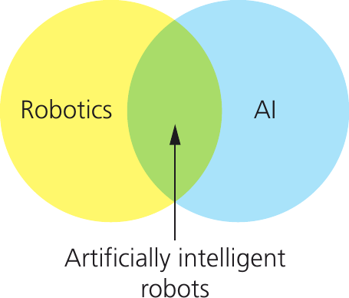
Robots and artificial intelligence
Activity 2
1
Robot without AI
A factory welding arm repeats the same programmed movement thousands of times. It never changes its own instructions.
2
Robot with AI
A weeding robot uses AI to tell a weed from a crop, and can learn from mistakes.
3
Machine learning
The ability of a robot to automatically adapt its own processes and data. Exam questions often ask you to name it.
Images: Hodder Cambridge IGCSE Computer Science, Chapter 6.2.
7
Notes:
Key point from the textbook (6.2.2): robotics and AI are almost two separate fields. Many robots have no AI because they do the same repetitive task every time (welding, spraying). Robots that also have AI sit in the overlap: they can adapt, for example by using machine learning. Exam link: 0478 May/June 2025 Q8(e) and May/June 2024 Q8(f) ask for the name of the ability to "automatically adapt their own processes": machine learning. AI itself is lesson 6.3.

Slide 8
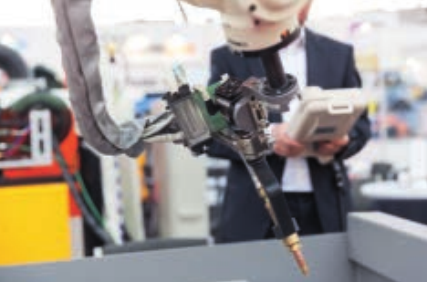
Independent and dependent robots
Activity 2
Independent
Dependent
Independent robot
No direct human control: it is autonomous
Can replace the human activity completely
Example: Mars rover, autonomous car
Dependent robot
A human interfaces with it directly (computer or control panel)
Supplements, rather than replaces, the human
Example: robots and people building a car together
Images: Hodder Cambridge IGCSE Computer Science, Chapter 6.2.
8
Notes:
Textbook 6.2.2. Independent = autonomous: no direct human control, can replace human activity completely (Mars rover, autonomous vehicle). Dependent: a human interfaces directly with it through a computer or control panel, and it supplements rather than replaces human activity (car assembly plant where humans and robots work together; a surgeon controlling a surgical robot). Ask: is a robot vacuum independent or dependent? Independent once started. A remote-controlled drone? Dependent; an autonomous delivery drone is independent.

Slide 9
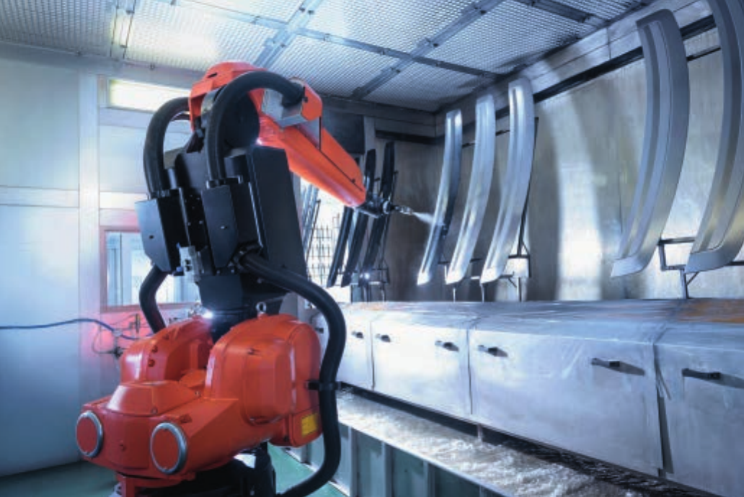
End-effectors and programming
Activity 3
1
Program a sequence
A programmer writes the list of instructions the arm follows, for example to spray a car body.
2
Guide the arm
A worker moves the arm by hand while it sprays. Each movement is stored as an instruction.
3
Copy a worker
A worker wears sensors and sprays the object. Position and rotation are recorded as instructions.
Robot arm with a spray gun end-effector
An end-effector is the tool attached to a robot arm so it can carry out a specific task: spraying, welding, cutting, gripping or lifting.
After that, every repeat is identical, so the product is consistent.
Images: Hodder Cambridge IGCSE Computer Science, Chapter 6.2.
9
Notes:
Textbook 6.2.3 (Industry). An end-effector is the attachment on the end of a robot arm that lets it do a particular task: spray gun, welding torch, gripper, cutter, suction cup. Changing the end-effector changes the job. Two ways to program: (1) a programmer writes a sequence of instructions; (2) a worker demonstrates the task, either guiding the arm by hand or wearing sensors on their own arm, and each movement is stored as an instruction. Once stored, every repeat is identical, giving a consistent product. Sensors stop it doing "stupid things", e.g. spraying when no car is present or when the paint has run out.

Slide 10
Robots in industry
Activity 3
Advantages
Work in conditions hazardous to humans
Work 24/7 without breaks
Cheaper in the long run (fewer wages)
More productive and more consistent
Better at boring, repetitive tasks
Disadvantages
Struggle with non-standard tasks
Unemployment in manual jobs
Deskilling of workers
Expensive to buy and set up
Welding, paint spraying, microchips, bottling, warehouses
Robots do heavy lifting, welding, paint spraying, making microchips and electrical goods, and finding items in automatic warehouses.
Images: Hodder Cambridge IGCSE Computer Science, Chapter 6.2.
10
Notes:
Textbook Table 6.1. Official points that match: 0478 May/June 2023 Q9(b) advantages TO EMPLOYEES: don't need to lift heavy furniture; protected from dangerous tasks; can use their skills on other tasks; don't need to do repetitive tasks. Q9(c) disadvantage TO OWNERS: expensive to install/set up; high maintenance costs; may deskill the workforce; if it malfunctions production may stop. Point out that the question says WHO the advantage is for: "less cost" is an owner advantage, not an employee one.

Slide 11
Transport: autonomous cars
Activity 4
Cameras, radar,
ultrasonic sensors
Microprocessor
compares with database
Actuators: brakes,
gears, steering
Advantages
Safer: human error removed
Less congestion, shorter journeys
Self-parking
Approaching a red light, step by step
1. Cameras recognise the red traffic light
2. The microprocessor checks its database for the action to take
3. It signals actuators to apply the brakes and select park
4. It keeps monitoring until the light turns green
5. It selects first gear, releases the brakes and opens the throttle, once it is safe
Disadvantages
Expensive to set up
Risk of hacking
Software glitches; sensors fail in snow
People reluctant; taxi jobs lost
11
Notes:
Textbook 6.2.3 (Transport). Sensors (radar, ultrasonics) and cameras are the car's eyes and ears; microprocessors process the data and send signals to actuators to change gear, apply the brakes and turn the steering wheel. Walk through the red light: recognise the sign, check its database, actuators brake and select park, keep monitoring, on green select first gear, release brakes, open throttle - while checking it is safe to move off. This is the same sensor - microprocessor - actuator answer chain students used in 6.1.

Slide 12
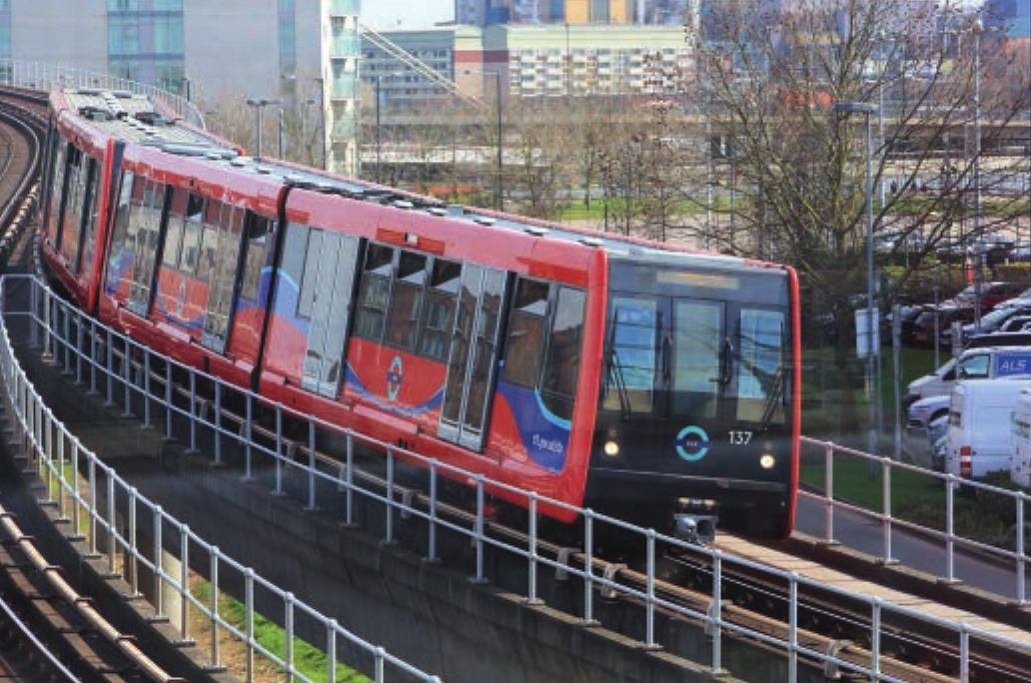
Transport: trains and planes
Activity 4
Autonomous trains | Pilotless planes
LiDaR builds a 3D image of the track | Sensors detect turbulence and loss of cabin pressure
Proximity sensors on doors, GPS for speed and position | GPS for navigation; actuators move throttle, flaps and rudder
+ More punctual, lower running costs, safer | + Lower running costs, safer (most crashes are pilot error)
- Hacking, high set-up cost, passenger behaviour | - Hacking, emergencies, software glitches, reluctance
Autonomous train (London)
Transport pattern: safer and cheaper to run, but expensive to set up, open to hacking, and people may not trust it.
Images: Hodder Cambridge IGCSE Computer Science, Chapter 6.2.
12
Notes:
Textbook Tables 6.3 and 6.4. Autonomous trains use LiDaR (light detection and ranging: lasers build a 3D image), proximity sensors on doors, infrared cameras and GPS; actuators control speed, braking and doors. Pilotless planes would use sensors for turbulence and cabin depressurisation, self-testing, GPS, and actuators for throttle, flaps and rudder. The repeated pattern across transport: advantages are safety (no human error), lower running costs and efficiency; disadvantages are cost, hacking, glitches and passenger reluctance.

Slide 13
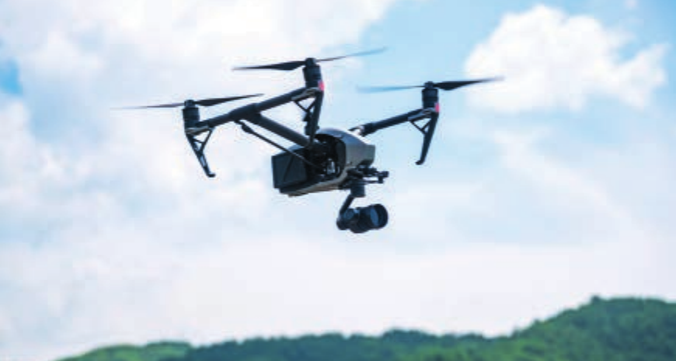
Agriculture
Activity 5
Use | How sensors and actuators help
Harvesting | Cameras check whether fruit is ripe; an arm picks it without damage
Weed control | AI tells a weed from a crop; GPS keeps it in the row; an actuator works the blade
Phenotyping | Sensors and thermal cameras build a 3D model to check plant health
Seed planting | Drones give a bird's eye view and plant and spray more accurately
Drones map fields, plant seeds and spread fertiliser
Advantages
More accurate, faster, less waste
Work without breaks
Disadvantages
Expensive; maintenance costs
Cannot adapt to the unexpected
Images: Hodder Cambridge IGCSE Computer Science, Chapter 6.2.
13
Notes:
Textbook 6.2.3 (Agriculture). Five areas: harvesting/picking (e.g. Vegebot uses cameras to decide whether a lettuce is ready), weed control (AI tells weed from crop; GPS keeps it on course; an actuator works the blade), phenotyping (sensors and thermal cameras build a 3D model of the plant; machine learning spots disease), seed-planting and fertiliser drones, and autonomous devices that work alone (mowers, weeding, seeding). Official points on farm robots: 0478 May/June 2024 Q8(d) advantages - more accurate, no breaks, not bored by repetitive work, farmer can do other tasks, faster, safer, no wages; Q8(e) disadvantages - expensive, maintenance, takes jobs, deskilling, training, manual planting if it breaks, damage if faulty, cannot adapt to unexpected events.

Slide 14
Medicine
Activity 5
Role | Why use a robot?
Surgery | Steadier and more precise: smaller cuts and faster recovery
Remote surgery | A specialist anywhere in the world can operate
Taking blood samples | Finds a good vein; protects staff from infectious patients
Disinfecting rooms | Autonomous robots clean operating theatres
Microbots | Deliver a drug to one target site, so less damage to tissue
Prosthetic limbs | Sensors and actuators give a human-like grip
1
Point + expansion
A 2-mark "explain" answer is a point and why it matters in this scenario: "The connection could be lost... so the surgery cannot continue."
2
Disadvantages
Expensive to buy and maintain; could be hacked; a malfunction or lost connection in the middle of surgery endangers the patient.
14
Notes:
Textbook 6.2.3 (Medicine). Official points, 0478 May/June 2025 Q5(b) (a doctor controls a surgical robot from another location): (ii) advantages, any four - doctor doesn't need to travel, so any specialist in the world can operate / no waiting for travel / not tired / travel costs saved; more precise, so smaller incision and shorter recovery; safer or more hygienic, e.g. doctor not near an infectious patient; higher success rate. (iii) one disadvantage with expansion - connection lost or delayed so surgery stops; expensive so money not spent elsewhere; hacked and endangers the patient; data corrupted in transmission changing an instruction; hardware malfunction. (i) electrical components: sensors, microprocessors, actuators.

Slide 15

Domestic robots and entertainment
Activity 5
Entertainment
Theme parks: robots dressed as characters interact with visitors
Festivals: robots control lighting, lasers and animation in time with the music
Film and TV: steady camera robots, stunt robots, special effects timed to the millisecond
In the home
Robot vacuum cleaners and lawn mowers: proximity sensors and cameras avoid obstacles
Personal assistants (Vector): microphone for voice, camera for faces, cloud connection
Pool cleaning, window cleaning, ironing
Domestic pattern: frees people from chores, but costly, and it can fail or be confused by an unusual room.
Images: Hodder Cambridge IGCSE Computer Science, Chapter 6.2.
15
Notes:
Textbook 6.2.3. Domestic: autonomous vacuum cleaners and lawn mowers use proximity sensors and cameras to avoid obstacles, a microprocessor to control the device (and let the user program it), and actuators driving motors. Personal assistants such as Vector use a microprocessor plus cloud connectivity, a microphone for voice commands, an HD camera for face recognition, and proximity sensors to navigate. Entertainment: theme park robots, lighting and effects at music festivals, camera robots that keep shots steady (the film Gravity), stunt robots and precisely synchronised special effects.

Slide 16
Exam focus: how a robot uses its sensors
Activity 6
1
Name the sensor
4
Decide
e.g. a proximity or infra-red sensor
Inside the range: carry on. Outside: send a signal
2
Continuous readings
5
Actuator acts
It continuously sends digitised data to the microprocessor
An actuator stops, turns or moves the robot
3
Compare
6
Repeat
The microprocessor compares the data with a stored value or range
The process repeats until the robot is switched off
Use the numbers in the question: "compares the reading with the stored value of 10 cm".
16
Notes:
Show AFTER students attempt booklet Task 4. Official points, 0478 May/June 2024 Q8(c) (farm robot stops at a fence, any six): proximity sensor used; sensor continuously sends digitised data to the microprocessor; microprocessor compares the data to a stored value/range; if within range the robot continues; if outside, the microprocessor sends a signal to turn/stop the robot; using an actuator; the process repeats until turned off. 0478 Feb/March 2023 Q6(c) is the same pattern for 7 marks (move forward until an object is 10 cm or closer, then turn 90 degrees right).

Slide 17
Exam focus: advantages to whom?
Activity 6
0478 May/June 2023 Q9: robots manufacture furniture | Marks | Credited answers
(a) One characteristic is that a robot is programmable. State two other characteristics. | 2 | Mechanical structure or framework; electrical components
(b) Give two advantages to company employees. | 2 | No heavy lifting; protected from danger; use skills elsewhere; no repetitive tasks
(c) Give one disadvantage to the company's owners. | 1 | Expensive to set up; maintenance costs; production stops if it breaks
1
Read who it is for
2
Name the context
Employees: safety, no heavy or boring work. Owners: cost, productivity, consistency. "Cheaper" is not an employee advantage.
"Workers don't need to lift heavy furniture" scores. "It is efficient" usually does not.
17
Notes:
Show AFTER students attempt Task 2 and Task 5. 0478 May/June 2023 Q9 (robots manufacture furniture): (a) other two characteristics: electrical components; programmable. (b) advantages to EMPLOYEES: no heavy lifting; protected from dangerous tasks; use skills on other tasks; no repetitive tasks. (c) disadvantage to OWNERS: expensive to install; high maintenance costs; may deskill the workforce; production stops if it malfunctions. 2023 specimen Q6(b) advantages of robots over humans: more efficient; more accurate; lift heavier equipment; replace humans in dangerous environments; lower running costs such as wages; consistent output; work 24 hours a day.

Slide 18
Guided practice
Activity 7
Booklet task | What you do | Uses slides
Task 2 Robot or not | Define robotics, characteristics, sort devices, match terms | 4-6
Task 3 Classify and apply | Independent or dependent? Choose end-effectors | 7-9
Task 4 Exam questions: sensors | Real 0478 questions on robots that sense and act | 11, 16
Task 5 Exam questions: roles | Advantages and disadvantages in context | 10-15, 17
Task 6 Extension | Robots exploring the sea bed and Mars | all
Check your answers against the exam focus pages when your teacher tells you to.
18
Notes:
Booklet tasks and their sources (answers on the exam focus slides and in these notes):
Task 2: robotics definition (Feb/March 2023 Q6(b)), characteristics (May/June 2023 Q9(a)), robot or not, matching terms (textbook Activity 6.9 Q2: no direct human control -> autonomous; requires human interface -> dependent robot; branch of computer science -> robotics; attached to a robotic arm -> end-effector; under microprocessor control operates pumps, wheels -> actuator).
Task 3: classify independent/dependent; choose end-effectors.
Task 4: May/June 2024 Q8(a)-(c) farm robot; Feb/March 2024 Q6(a),(b)(ii),(c) self-driving tractor - (a) electrical components or programmable; (b)(ii) e.g. accelerometer for uneven ground, proximity for the end of the field, light for headlights; (c) set-up and maintenance cost, needs skilled workers, retraining, deskilling, unemployment, malfunction and failing to recognise a person.
Task 5: May/June 2023 Q9(b)(c); May/June 2025 Q8 (firmware: permanent instructions stored in ROM / software that controls the hardware; interrupts e.g. obstacle, emergency stop, battery low, hardware error, overheating; workers - no heavy lifting, fewer injuries, no repetitive tasks, new maintenance jobs; machine learning); May/June 2025 Q5(b) surgery.
Task 2(c) suggested: delivery drone - yes (frame and rotors, sensors/microprocessor/motors, programmable); electric toothbrush - no (moves but is not programmable and does not sense); website chatbot - no (software only, no mechanical structure); welding arm - yes; pool-cleaning robot - yes.
Task 3(a) suggested: Mars rover I (no direct human control); surgical robot D (surgeon interfaces through a console); vacuum I; bomb-disposal D (remote control); driverless train I; assembly-line arm D (supplements the worker). (b) welding torch/gun; spray gun; soft gripper or suction cup; cutter or laser. (c) a programmer writes a sequence of instructions; a worker guides the arm by hand and each movement is stored; or the worker wears sensors while spraying and the movements are recorded - then repeated identically. (d) they repeat the same programmed task and do not need to adapt. (e) machine learning (official).
Task 6 suggested: (a) cameras/lights photograph the wreck, sonar or proximity sensors keep a safe distance, pressure/depth sensors; the microprocessor processes sensor data and sends signals to actuators to steer thrusters, aim the camera and work the arm/gripper to collect a sample; repeated continuously. (b) navigation and avoiding rocks; photographing the surface to send back; locating and guiding the arm to soil samples. (c) + no risk to human life, works in extreme pressure/vacuum, works for long periods; - very expensive, cannot be repaired if it fails, communication delay or loss, cannot cope with the unexpected.
Task 6: textbook Activity 6.11 Q5.

Slide 19
Common misconceptions
Plenary
Misconception | Why it is wrong
"A chatbot is a robot." | It is software only. A robot is a physical machine.
"All robots have AI." | Most repeat programmed tasks. Only robots that adapt use AI.
"Anything that moves is a robot." | It also needs electrical components and must be programmable.
"The sensor decides what to do." | The sensor only measures. The microprocessor decides; the actuator acts.
"Robots are always more accurate." | They are more consistent, but struggle with non-standard tasks.
"It is cheaper" as an advantage to workers | Cost matters to the owner. Workers gain safety and less repetitive work.
19
Notes:
Go through these after Task 5. Ask students which ones they wrote in Task 1 or Task 2.

Slide 20
Exit question
Plenary
A delivery robot moves along a hospital corridor. It must stop if a person is 1 metre or closer in front of it.
Explain how a sensor, a microprocessor and an actuator are used to do this. [5]
20
Notes:
Answer (based on the official points for Feb/March 2024 Q6(b)(i), 5 marks): an infra-red/proximity sensor continuously sends digitised readings to the microprocessor; the microprocessor compares the reading with the stored value of 1 metre; if a person is 1 metre or closer, it sends a signal to an actuator to stop the wheels; if not, no action and it keeps moving; the process repeats until the robot is switched off.

Slide 21
In this lesson, you
Summary
Defined robotics as the design, construction and operation of robots
Learned the three characteristics: mechanical structure, electrical components, programmable
Classified robots as independent or dependent, and saw how end-effectors change a robot's job
Used the sensor, microprocessor, actuator chain to explain how robots act
Gave advantages and disadvantages in six areas, and for different people
Next lesson: 6.3 Artificial intelligence
21
Notes:
Next lesson: 6.3 Artificial intelligence (expert systems and machine learning).

